Slide 1
Heterogeneous Data Warehouse Analysis and Dimensional Integration
International Doctorate School in
Information and Communication Technologies
Università degli Studi di Modena e Reggio Emilia
Marius Octavian Olaru
XXVI Cycle
Computer Engineering and Science
Advisor: Prof. Maurizio Vincini
Co-Advisor: Prof. Sonia Bergamaschi

Slide 2
Outline
Problem statement
Definition and Business motivation
Dimension Integration
Dimension mapping
Schema integration
Instance integration
Mapping quality analysis

Slide 3
Problem Motivation – BusinessWise
Several scenarios where managers need to combine strategic information
Company merges & acquisitions
Virtual Enterprises
Networks of CO-Opetition (simultaneous collaboration & competition)
Take strategic decisions based on information from ALL the companies
Integrate the Business Intelligence repositories (Enterprise DWs)

Slide 4
Problem Statement
DW Integration = combine information from two or more heterogeneous DWs and provide users a unified view
A specific, context dependent, data-integration problem
The context is a priori knowledge about the schema that can be exploited for: schema matching, schema integration, schema resolution, etc…

Slide 5
Contribution
A complete, automatic methodology for the integration of heterogeneous DW dimensions
Mapping discovery
Schema integration
Instance integration

Slide 6
Phase 1 – mapping discovery
Main observations
Use context specific solutions vs. classical approaches (e.g., semantics)
A priori knowledge about the dimension schemas (directed graphs)
Different working groups represent information in a similar manner, according to the common understanding of the concept of interest

Slide 7
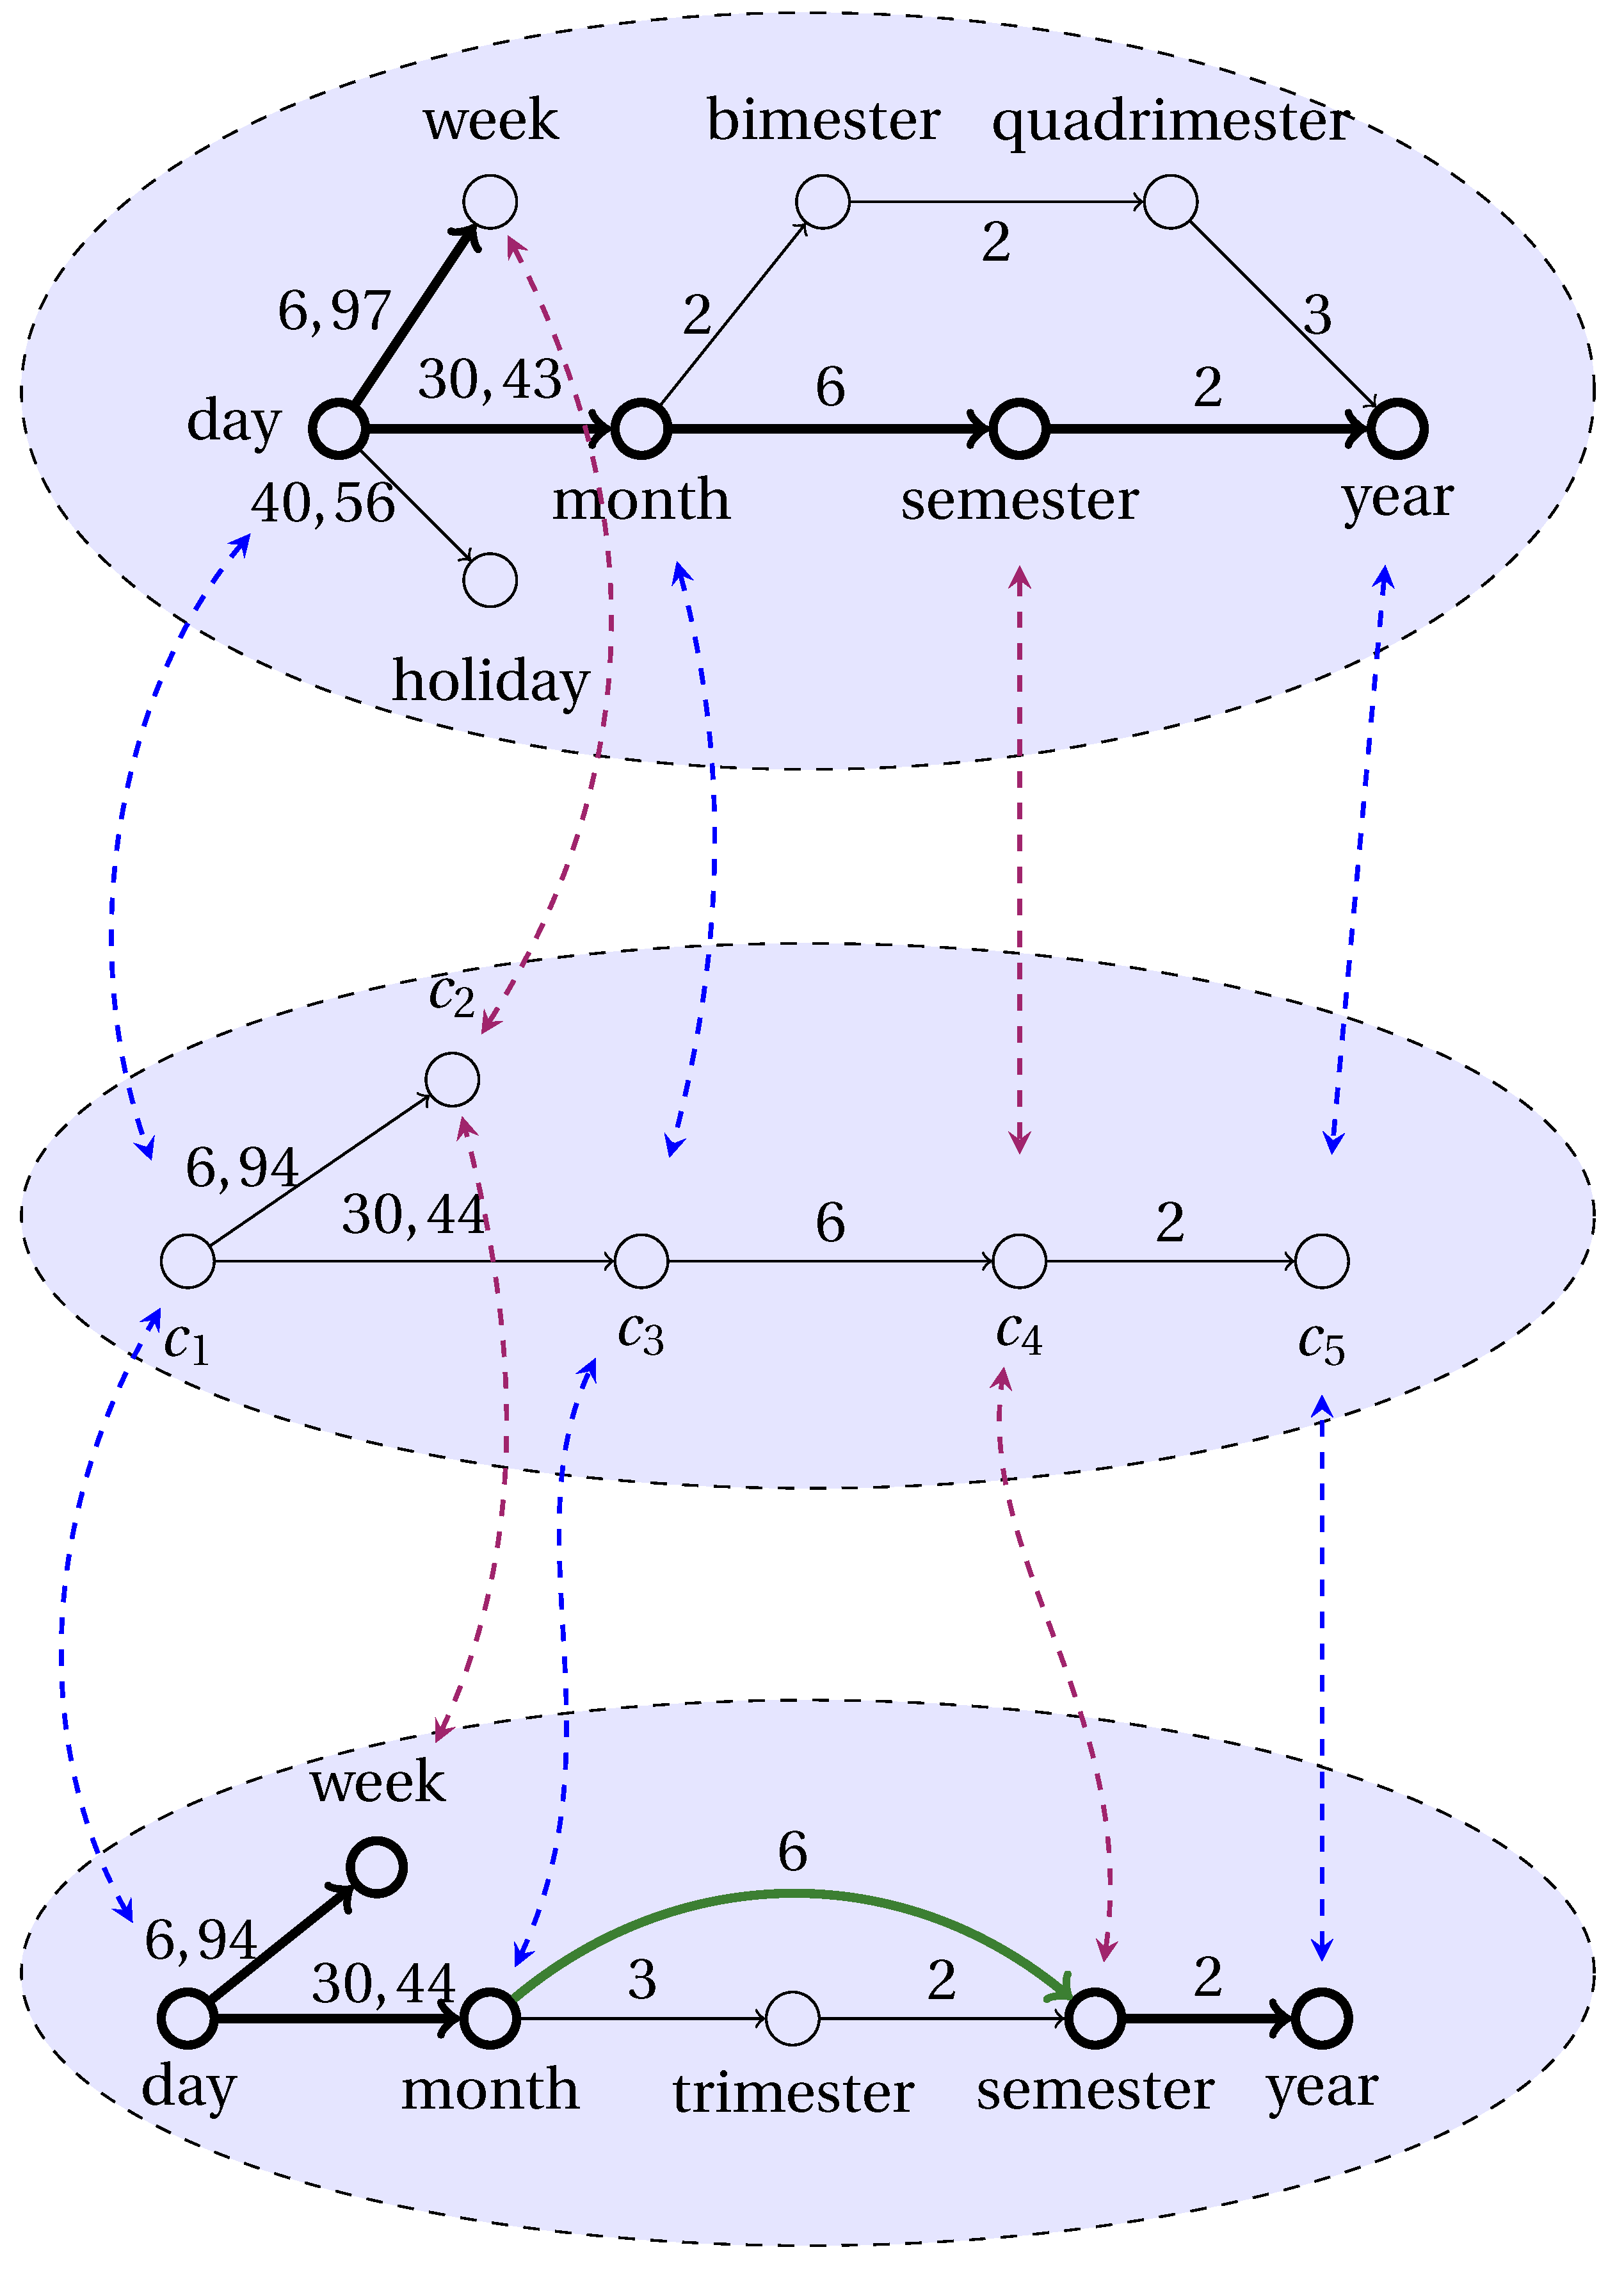
Phase 1 – mapping discovery
Consider two dimensions as directed labelled graphs
annotate with instance data – cardinality ratio between aggregation levels
Generate a common structure recurring in the initial graphs
Use it to identify pairs of common nodes
Exact algorithm vs. Approximate algorithm [depends on the instances]
Generate sets of complex semantic mappings

Slide 8
Phase 1 – Experimental Evaluation
Three real DWs
Attempted the mapping of pairs of dimensions
Time dimensions
Geographic dimensions
Article dimensions
day |  |  | postcode |  |  | article
overlapping | ε |  | overlapping | ε |  | overlapping | ε
75 % | 0,1 % |  | 16 % | 12 % |  | 0 % | 4 %

Slide 9
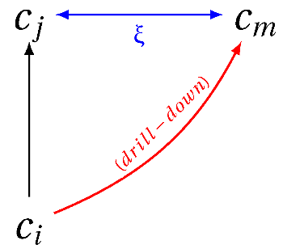
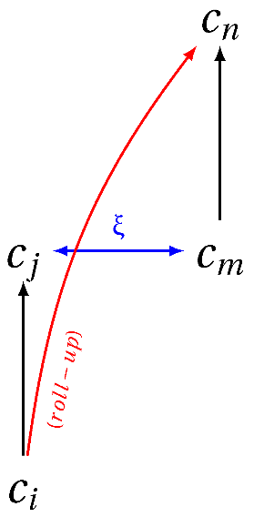
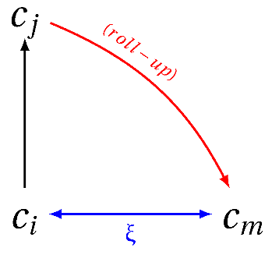
Complex Mappings
Two mapped categories express the same concept at the same level of granularity (equi-level)
It is possible to define more complex mappings for query reformulation in distributed environments¹
equi-level
roll-up
drill-down
related
Semantic validation using the Combined WordSense Disambiguation Technique (CWSD)
¹Golfarelli, M., Mandreoli, F., Penzo, W., Rizzi, S., & Turricchia, E. (2011). OLAP Query Reformulation in Peer-to-Peer Data Warehousing. Information Systems, 37(5).

Slide 10
Phase 2 – Schema Integration
When writing a global query on a network of heterogeneous peers, depending on schema compatibility, the query may be:
Executed on all the peers, because all are compatible with the query
Executed on a subset of the peers
Executed only on the local node
Resolute approaches
Allow only compatible queries vs. Allow all queries
Inform the user vs. Not inform the user
Confusion vs. Misleading results

Slide 11
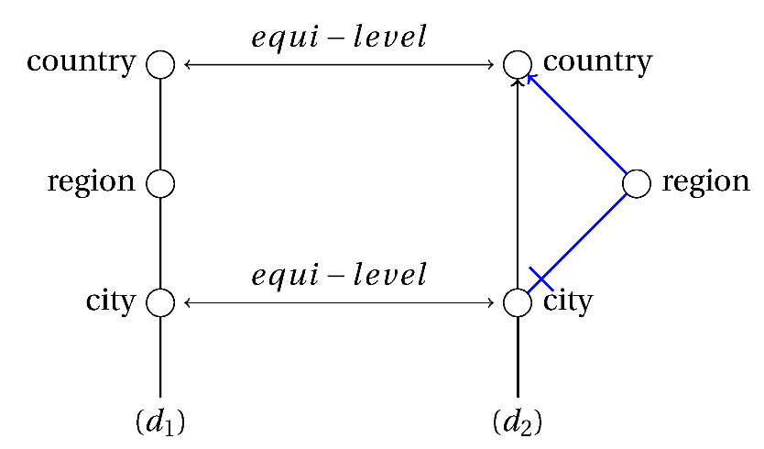
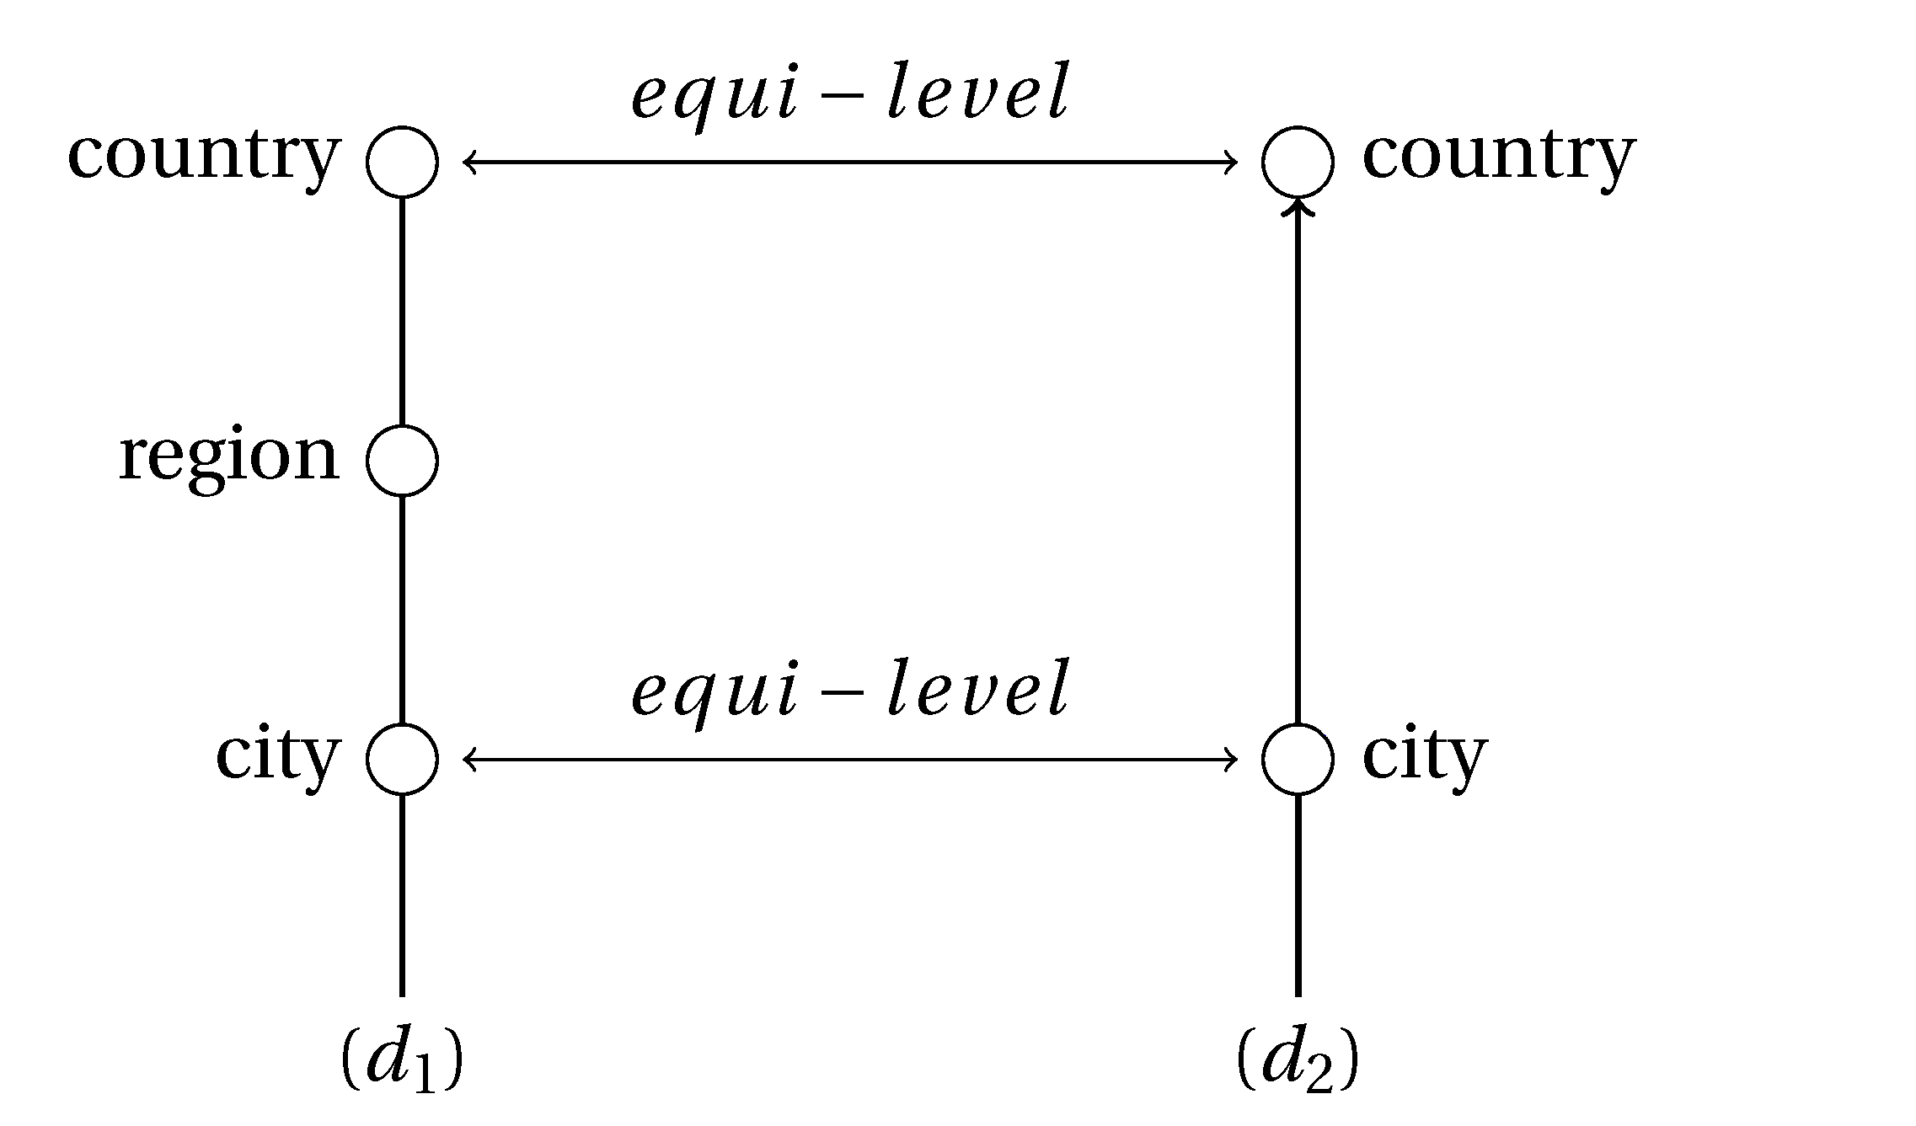
Phase 2 – Schema Integration
Solution: import compatible parts of remote dimension schemas
Uniform dimensions = uniform queries
Increased querying capabilities for local nodes

Slide 12
Phase 3 – Instance Integration
Two possible solutions:
The dimension chase procedure (d-chase)
Based on the chase algorithm for reasoning on functional dependencies
Suitable for exact matching attribute values
RELEVANT clustering approach
Based on syntactic similarity, dominance measure and lexical similarity
Suitable for realistic scenarios, where values may be slightly different
E.g.: Emilia Romagna vs. E. Romagna

Slide 13
Integration architectures
The proposed approach is architecture independent
Peer-to-peer network of DWs
Federation of DWs
Algorithm for constructing a global dimension from n matched dimensions
Central DW (=union and reconciliation of all DWs)
Main advantage: flexibility

Slide 14
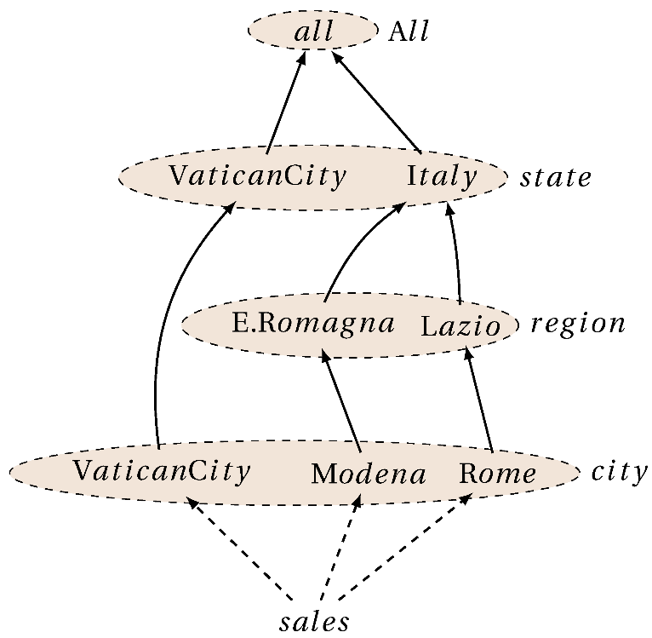
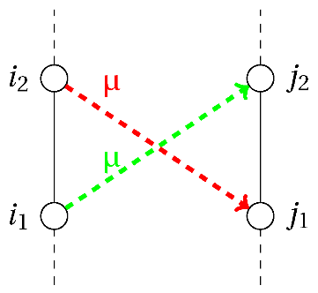
Dimension mapping properties
The quality of integrated information depends on the accuracy of the mappings
Three dimension mapping properties¹:
Coherency
Soundness
Consistency
One dimension property²:
Homogeneity: important for summarizability and materializing dependent GROUP BY queries
¹Cabibbo, L., & Torlone, R. (2005). Integrating heterogeneous multidimensional databases. SSDBM 2005
²Hurtado, C. A., Gutierrez, C., & Mendelzon, A. O. (2005). Capturing summarizability with integrity constraints in OLAP. ACM Transactions on Database Systems, 30(3)

Slide 15
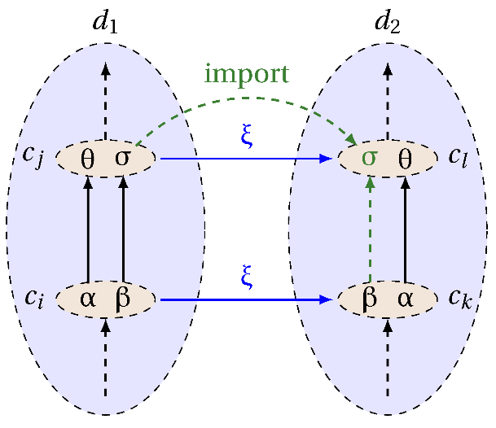
Dimension mapping properties
The generated mappings are always coherent
Soundness and consistency are always maintained
In some cases, soundness and consistency are obtained
The properties are conservative, non degenerative.
Beneventano, D., Olaru, M.-O., & Vincini, M. (2013). Analyzing Dimension Mappings and Properties in Data Warehouse Integration. ODBASE 2013 (LNCS 8185)

Slide 16
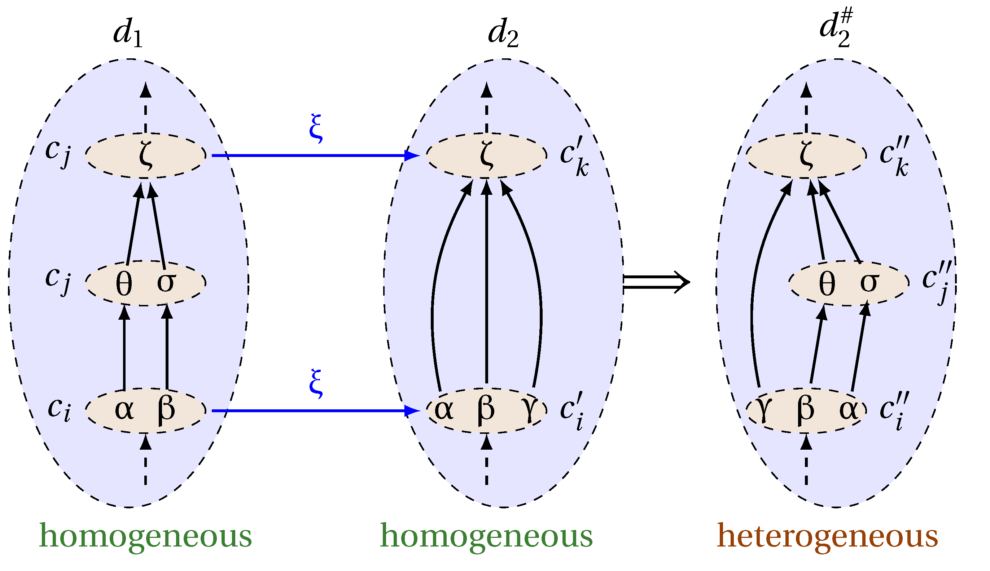
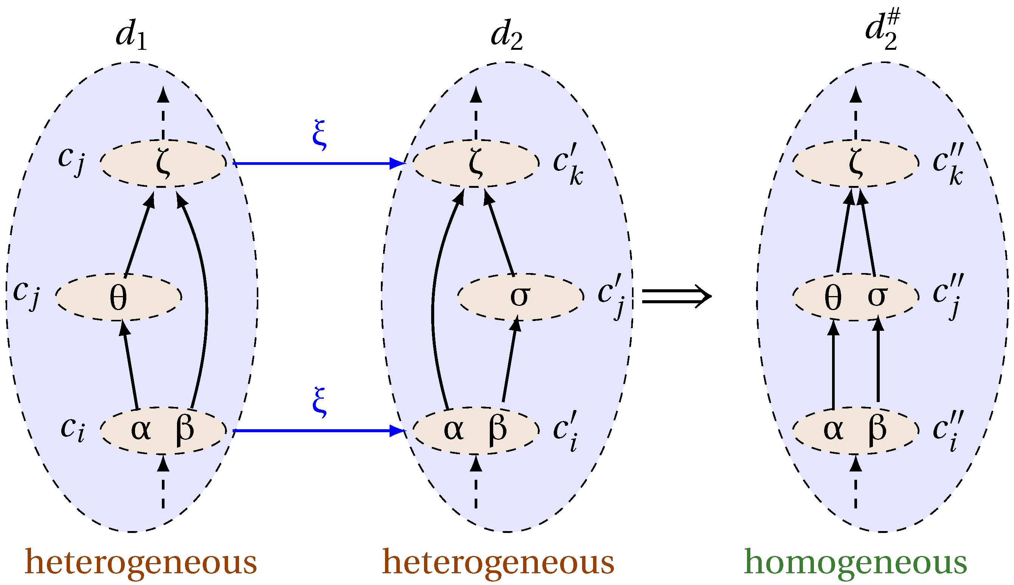
Checking Homogeneity
Homogeneity/heterogeneity is independent
Sufficient condition for maintaining homogeneity involving base categories was formulated in the thesis

Slide 17
Conclusions
A complete, heterogeneous DW dimension integration methodology
Context specific problem = context specific solution:
Mapping discovery = graph matching (+semantics)
Schema integration:
Solve heterogeneities
Increase local querying capabilities
Instance integration
Exact approach
Suitable for exact values (e.g., dictionaries)
Clustering approach
Suitable for real-life cases
Good quality properties

Slide 18
List of Relevant Publications
International Conferences:
Bergamaschi, S., Olaru, M.-O., Sorrentino, S., & Vincini, M. (2012). Dimension matching in Peer-to-Peer Data Warehousing. In DSS 2012
Olaru, M.-O., & Vincini, M. (2012a). A Dimension Integration Method for a Heterogeneous Data Warehouse Environment. In ICETE 2012
Olaru, M.-O. (2012). Partial Multi-dimensional Schema Merging in Heterogeneous Data Warehouses. In ER2012 - PhD Symposium
Guerra, F., Olaru, M.-O., & Vincini, M. (2012). Mapping and Integration of Dimensional Attributes Using Clustering Techniques. In EC-WEB 2013
Beneventano, D., Olaru, M.-O., & Vincini, M. (2013). Analyzing Dimension Mappings and Properties in Data Warehouse Integration. ODBASE 2013 (LNCS 8185)
Book Chapters
Olaru, M.-O., & Vincini, M (2014). A Data Warehouse Integration Methodology in Support of Collaborative SMEs. In Organizational Transformations through Big Data Analytics [submitted]

Slide 19
Thank you

