Slide 1
Bayesian Networks
Optimization of the Human-Computer Interaction process in a Big Data Scenario
Thesis Coordinator:
Sonia Bergamaschi
(University of Modena and Reggio Emilia)
Thesis Advisor:
H. V. Jagadish
(University of Michigan)
Candidate:
Emanuele Charalambis
University of Modena and Reggio Emilia

Slide 2
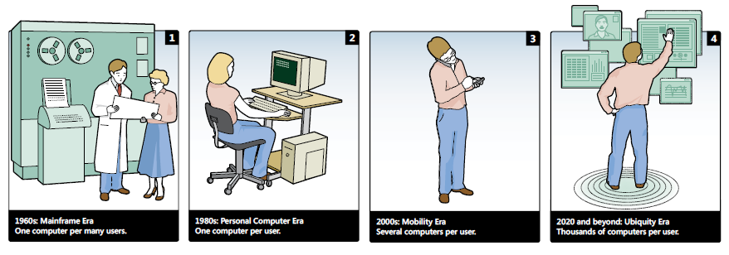
Human-Computer Interaction
Functionality
of a system is defined by the set of actions or services that it provides to its users
Usability
of a system is the range and degree by which the system can be used efficiently and adequately to accomplish certain goals for certain users

Slide 3
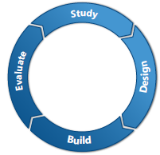
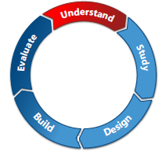
Intelligent Adaptive Interfaces
Common HCI design
Passive in nature
Static
Intelligent HCI design
Active
Concept of Understanding
Conventional user-centred design/research model
Extended user-centred five-stage design/research model

Slide 4
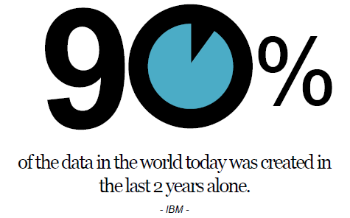
Big Data Overview
Volume
Velocity
Variety

Slide 5
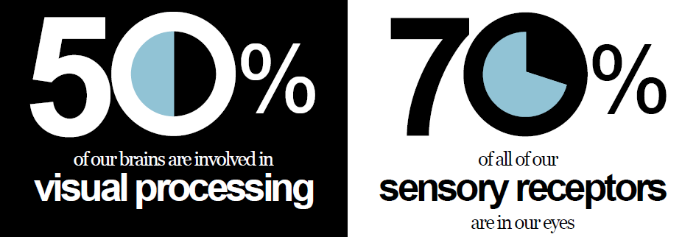
Big Data Visualization
Visualization helps make data cleaner and more engaging
Visualization helps make data actionable and easier to manage

Slide 6
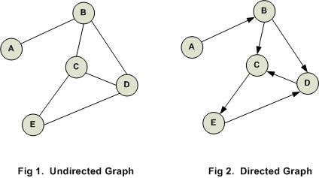
Probabilistic Graphical Models
Probabilistic Graphical Models (PGMs) is a way of representing probabilistic relationships between random variables
Variables are represented by nodes
Conditional (in)dipendencies are represented by (missing) edges
Undirected edges simply give correlations between variables (Markov Random Field)
Directed edges give causality relationships (Bayesian Networks)

Slide 7
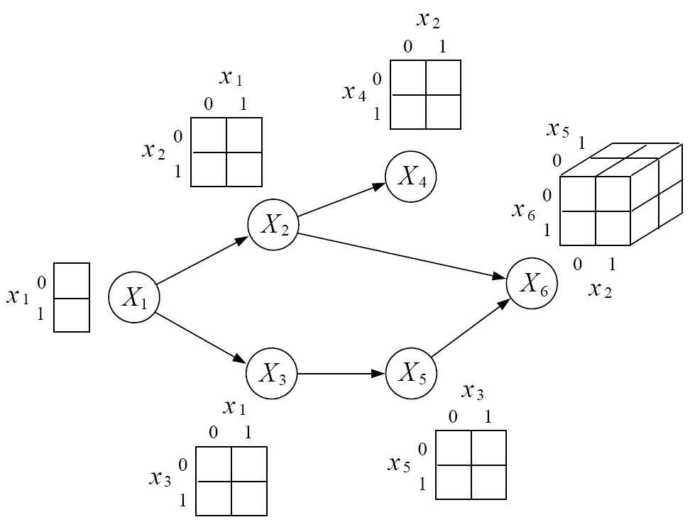
Bayesian Networks
Encodes the conditional independence relationships between the variables in the graph structure
Compact representation of the joint probability distribution over the variables
Bayesian networks are used for modelling knowledge in computational biology, bioinformatics, medicine, finance, information retrieval
A Directed Acyclic Graph
A set of table for each node in the graph
Each node in the graph is a random variable, an arrow from a node X to node Y means X has a direct influence on Y

Slide 8
Bayesian Networks Inference
Using a Bayesian network to compute probabilities is called inference
Inference involves queries of the form P(X|E)
X = The query variable(s)
E = The evidence variable
Exact Inference
Variables Elimination
Recursive Conditioning
Approximate Inference
Variational Methods
Monte Carlo Methods

Slide 9
Software for PGMs
Name | Source | API | Exec | Cts | GUI | Par | Str | Utl | $ | Graphs | Inf
Blaise | Java | Y | - | Y | N | Y | N | N | 0 | Fgraph | Approx (MCMC)
BNT | Matlab/C | Y | WUM | G | N | Y | Y | Y | 0 | D,U | Exact, Approx
BUGS | N | N | WU | Cs | W | Y | N | N | 0 | D | Approx (Gibbs)
Infer.NET | C# | Y | Y | Y | N | Y | N | N | 0 | Y | VMP, Gibbs (Approx)
JAGS | Java | Y | - | Y | N | Y | N | N | 0 | Y | Gibbs (Approx)
OpenMarkov | Y | Y | Java (WUM) | Cs,Cd | Y | Y | Y | Y | Y | D,U | Exact (Jtree, VarElim)
SamIam | N | N | Java (WUM) | G | Y | N | N | N | 0 | D | Exact (Recursive Cond)

Slide 10
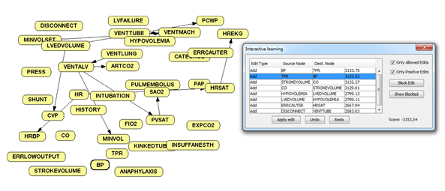
Learning BNs with OpenMarkov
OpenMarkov is able to represent several types of networks, such as Bayesian networks, Markov networks, influence diagrams as well as several types of temporal model. The learning algorithm used is Hill Climbing.
The algorithm proposes some incremental modifications of the network, based on the information contained in the database, and the user has the opportunity to apply some of the changes proposed by the tool or impose others at any moment of the learning process.

Slide 11
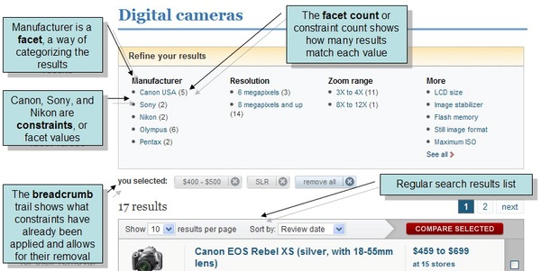
Case Study Faceted Browsing
Facets Optimization:
Use a static order that does not change as the user navigates.
Dynamically rank the order of presentation of facets based on their estimated utility.
Organize similar or related facets into groups.

Slide 12
Apache Solr
Major features:
Powerful full-text search
Faceted search
Dynamic clustering
Rich document handling
Highly reliable
Scalable
Fault tolerant
Distribuited indexing
Load-balanced querying
Written in Java and runs as a standalone full-text search server within a servlet container such as Jetty.
Uses the Lucene Java search library at its core for full-text indexing and search, and has REST-like HTTP/XML and JSON APIs that make it easy to use from virtually any programming language.

Slide 13
Grouping Top-K facets
Using Bayesian Networks to define the correlations between different facets
No-feedback is needed from the user
Different facets represent different aspects of a data and all the diverse aspects may not be equally important to be shown as possible facets.
Grouping related information is often useful because it reduces the amount of back-and-forth browsing that is required by the user.
If related facets are placed adjacently, then the user can easily see the effect of selecting the values on one facet on the related facets.
HCI Interaction
Facets Grouping
JavaScript + Servlet
BN structure learning
OMarkov API

Slide 14
Query Recommendation System
Using Bayesian Networks to build an interactive recommendation system for the user’s search query
HCI Interaction
JavaScript + Servlet
PRE Matrix Computation
UNALTERED
OMarkov API
Standard Deviation Computation
ADDED
Top5 Facets SORTING
POST Matrix Computation
DELETED
For each value of probability it will be calculated the standard deviation between the value in the PRE matrix and the value in the POST.
Now I can define if a certain facet can be added into the category: ADDED, UNALTERED or DELETED

Slide 15
Query Recommendation System
Using this approach the user is facilitated in his process of search because every time he hovers over a facet he will have real-time knowledge of how the eventual selection will affect the search
Facets Categories
Unaltered
Added
Deleted
Figure representing the test made in a mushrooms dataset

Slide 16
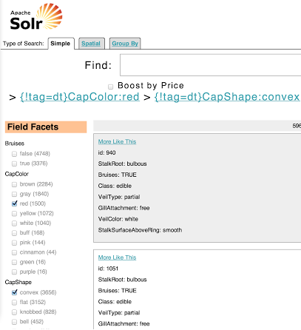
Dynamic Summary
Using Bayesian Networks to optimize the visualization of the result-set
Query Execuion
Result-set Visualization
JavaScript + Servlet
Top5 Facets Computation
OMarkov API + BN

Slide 17
Conclusions
Analysis of Human-Computer Interaction (HCI) process and User Experience (UX) problems in a Big Data scenario.
Analysis of Probabilistic Graphical Models (PGMs), their structure and their use.
Analysis of directed acyclic graphs, Bayesian Networks (BNs), both in terms of theory and of actual implementation.
Comparison between the existing software packages to model BNs and to interactively learn BNs from datasets.
Analsys of a case study: Faceted Browsing.
Development of a software solution that optimizes the UX in Apache Solr through three different algorithms.

Slide 18
Thank for your time

