Slide 1
Faceted Browsing: Analysis and implementation of a Big Data Solution using Apache Solr.
April 15, 2014
Advisor:
Prof. Sonia Bergamaschi
Co-Advisor:
Prof. H.V. Jagadish
Dott. Ing. Francesco Guerra
Paolo Malavolta
University of Modena and Reggio Emilia

Slide 2
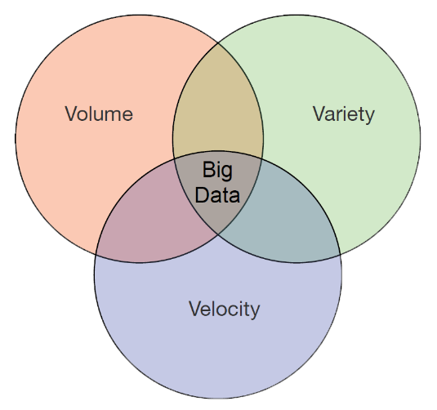
Big Data visualization
90% of the data in the world today was created in the last 2 years alone. -IBM-
Why should we be interested in visualization? Because the human visual system is a pattern seeker of enormous power and subtlety. The eye and the visual cortex of the brain form a massively parallel processor that provides the highest-bandwidth channel into human cognitive centers. At higher levels of processing, perception and cognition are closely interrelated, which is the reason why the words “understanding” and “seeing” are synonymous.
-Colin Ware, 2000-
50% of our brains are involved in visual processing | 70% of all of our sensory receptors are in our eyes
Notes:
as you need not to start from scratch = non dovendo così partire da 0

Slide 3
Apache Solr
Solr (pronounced “solar”) is the most popular and open source enterprise search platform from the Apache Lucene project. Its major features include:
Full-text search,
Dynamic clustering,
Near Real-time indexing,
Traditional DB, rich document (e.g., Word, PDF, jpeg) handling,
NoSQL DB support,
HTTP Restfull requests.
Notes:
as you need not to start from scratch = non dovendo così partire da 0

Slide 4
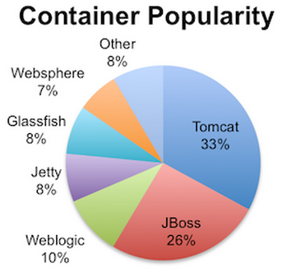
Big Data solution
Jetty
Tomcat
Jetty features: | Tomcat features:
Full-featured and standards-based. Embeddable and Asynchronous. Open source and commercially usable. Dual licensed under Apache and Eclipse. Flexible and extensible, Enterprise scalable. Low maintenance cost. Small and Efficient. | Famous open source under Apache. Easier to embed Tomcat in your applications. Implements the Servlet 3.0, JSP 2.2 and JSP-EL 2.2 support. Strong and widely commercially usable and use. Easy integrated with other application such as Spring. Flexible and extensible, Enterprise scalable. Faster JSP parsing. Stable.
Notes:
as you need not to start from scratch = non dovendo così partire da 0

Slide 5
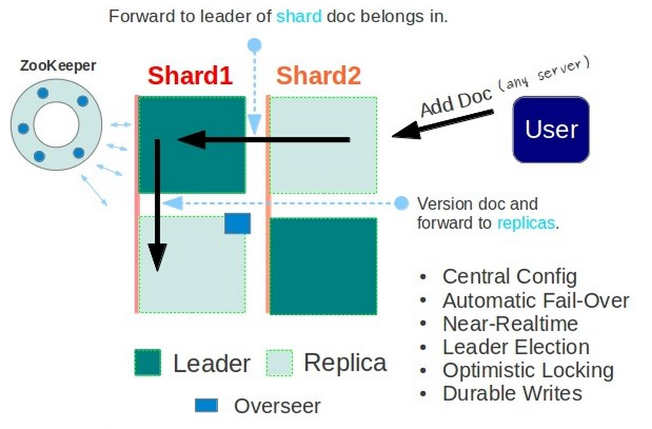
Big Data solution
Solr
Tomcat
Apache ZooKeeper:
Sharding
Replication
Notes:
as you need not to start from scratch = non dovendo così partire da 0

Slide 6
Big Data solution
Solr
Tomcat
Apache ZooKeeper:
Sharding
Replication
Hadoop Distributed File System (HDFS)
Big Data solution
over
Apache Solr
Notes:
as you need not to start from scratch = non dovendo così partire da 0

Slide 7
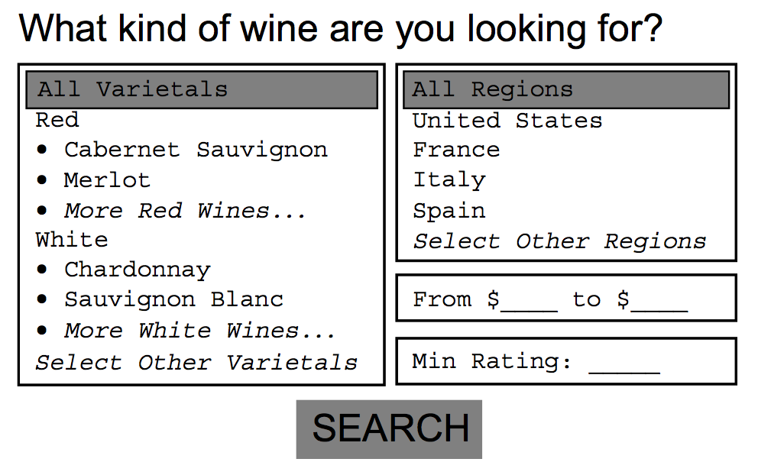
Faceted Browsing
Work Solr over Big Data → DONE
Big Data visualization over Solr → NOT YET!
WE NEED IT
Notes:
as you need not to start from scratch = non dovendo così partire da 0

Slide 8
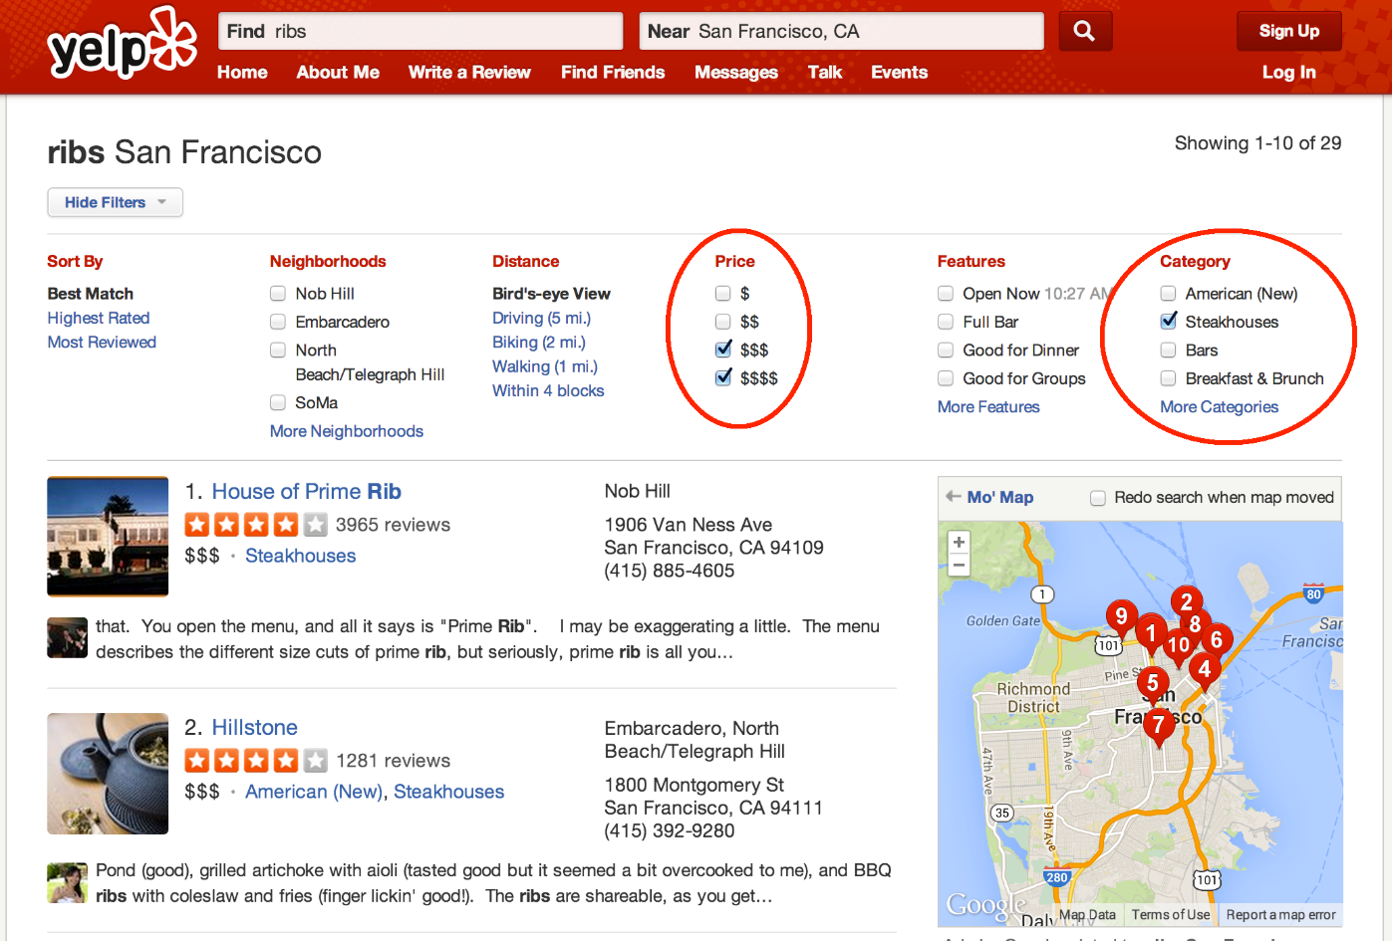
Faceted Browsing
Faceted Browsing over Solr
AND between facets
OR within facet
Notes:
as you need not to start from scratch = non dovendo così partire da 0

Slide 9
Faceted Browsing
Faceted Browsing concerns:
Checkbox
Scale
Efficiency
CAPCOLOR (79)
[x] Brown (23)
[x] Gray (45)
[ ] Red (11)
CAPSURFACE (18)
[ ] Scaly (7)
[ ] Smooth (11)
ODOR (183)
[ ] None (34)
[x] Pungent (80)
[ ] Spicy (65)
[ ] Anise (4)
Notes:
as you need not to start from scratch = non dovendo così partire da 0

Slide 10
Faceted Browsing
How to make Faceted Browsing over Solr:
Analysis and learning of a multi-faceted query
Modified Solr front-end
Added javascript
http://localhost:8081/solr/collection1/browse?
&q=&fq={!tag=dt}CapColor:brown%22OR%22{!tag=dt}CapColor:gray
&q=&fq={!tag=dt}Odor:pungent
&facet=on
&facet.field={!ex=dt}CapColor
&facet.field={!ex=dt}CapSurface
&facet.field={!ex=dt}Odor
Notes:
as you need not to start from scratch = non dovendo così partire da 0

Slide 11
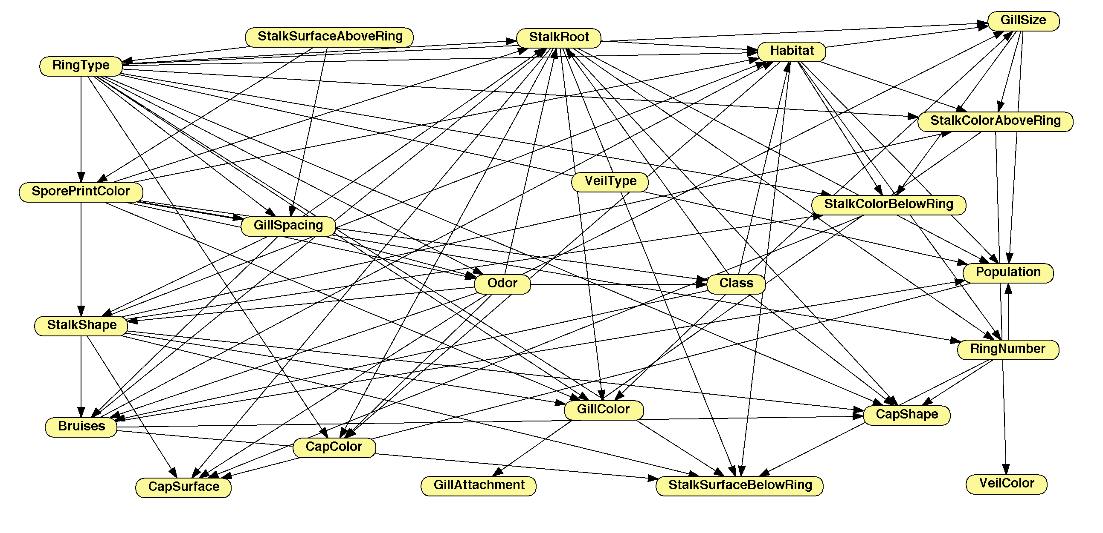
Bayesian Networks
Issues:
Huge volume of facet
User search experience
How:
Bayesian networks
Open Markov
Open source
GUI available
API available
Notes:
as you need not to start from scratch = non dovendo così partire da 0

Slide 12
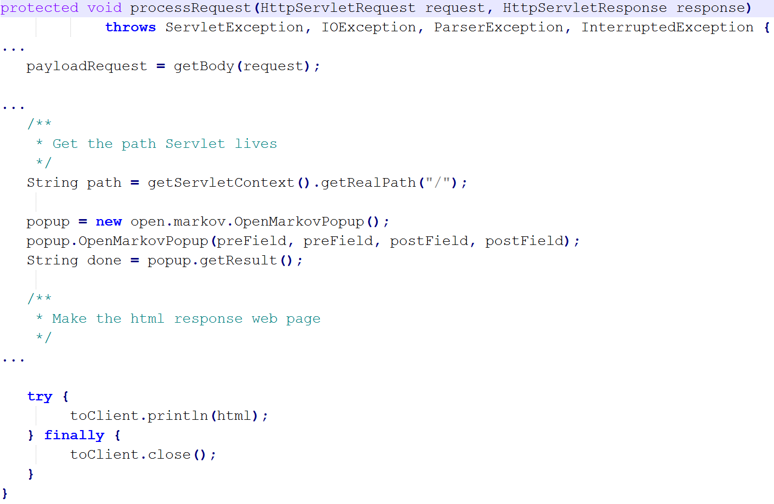
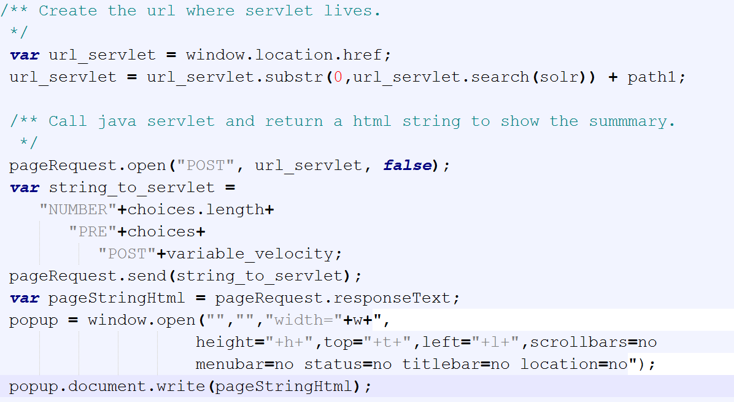
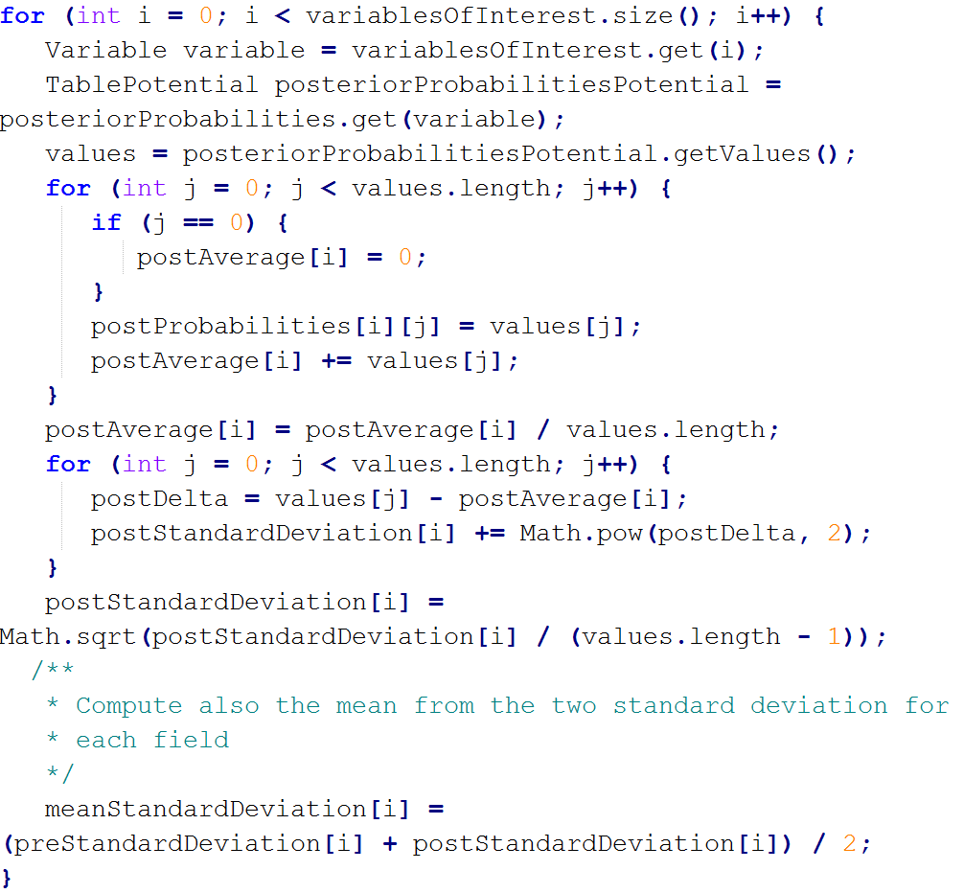
Bayesian Networks
How to:
Added javascript
Added Servlet
Open Markov API modified
Notes:
as you need not to start from scratch = non dovendo così partire da 0

Slide 13
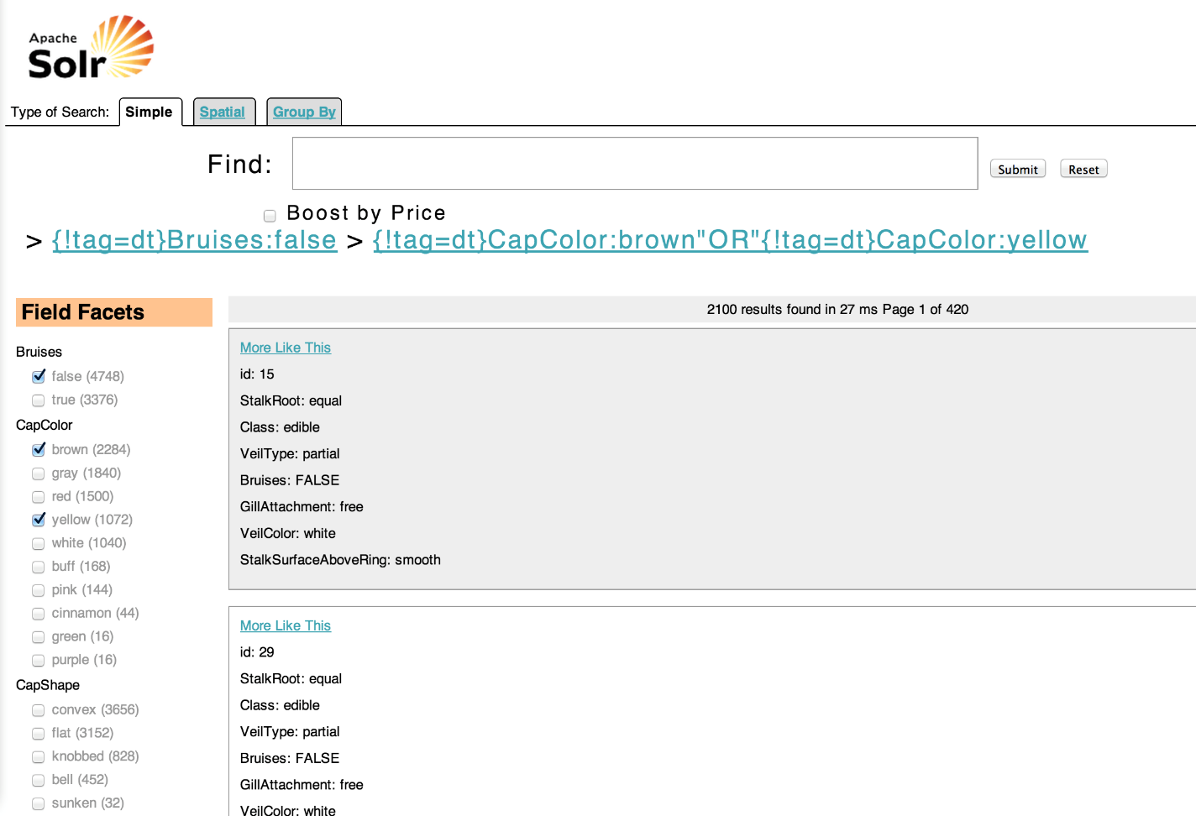
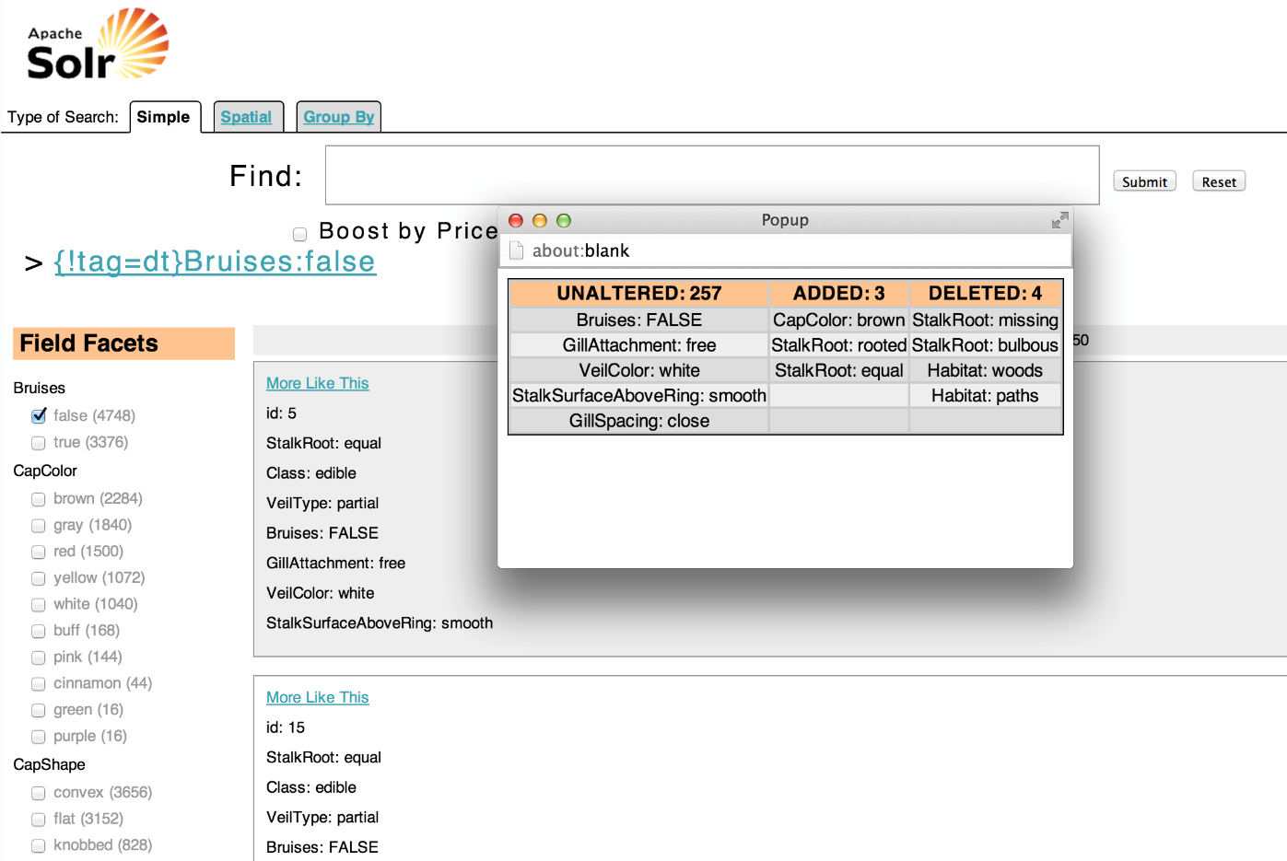
Bayesian Networks
Aware User Search
Dynamic Summary
Notes:
as you need not to start from scratch = non dovendo così partire da 0

Slide 14
Keywords Search
Keywords Search over Relational Database:
Very popular method
Allow non-expert user to formulate queries
Not needed to how the data is represented inside DB
Current techniques:
A-priori instance analysis
Construct an index
Retrieve information from index
Experimented approach:
Learning Bayesian Network from DB
Nodes represents columns
Retrieve information from BN
Notes:
as you need not to start from scratch = non dovendo così partire da 0

Slide 15
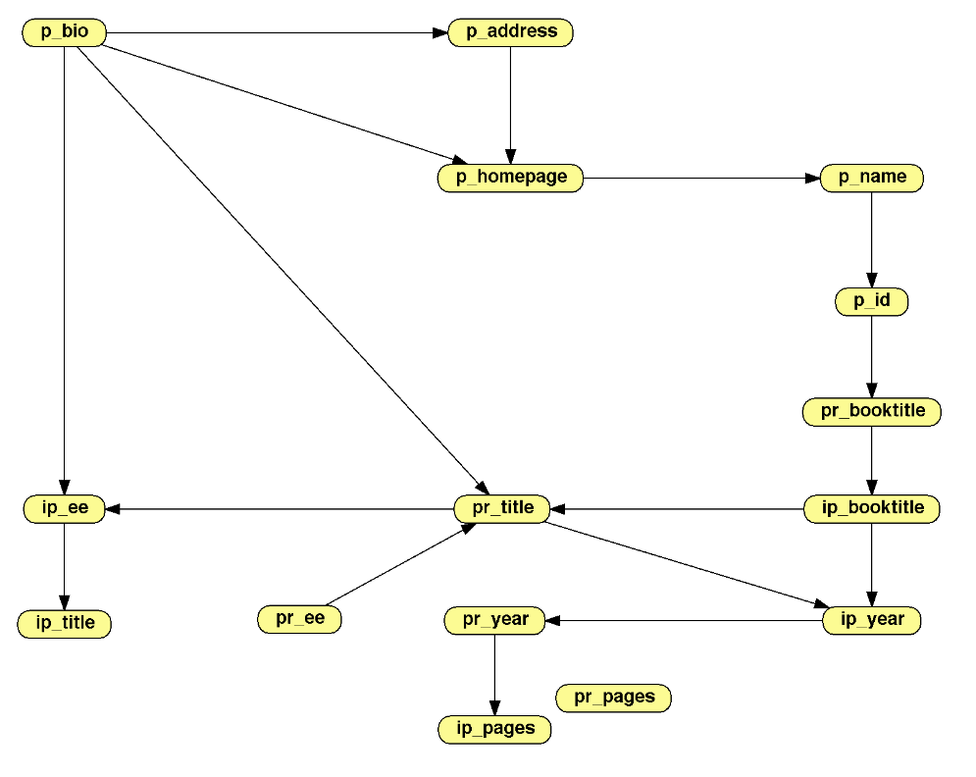
Keywords Search
How it works:
Learning Bayesian Network
Automatic Hill Climbing algorithm
Compute probabilities:
Variable Elimination algorithm
Print results:
Quick Sort algorithm
Notes:
as you need not to start from scratch = non dovendo così partire da 0

Slide 16
Keywords Search
Test:
Portion of a real DB
2-way path
Full outer join:
First 1000 rows
50 runs
Execution time: ~ 3.0 sec.
Notes:
as you need not to start from scratch = non dovendo così partire da 0

Slide 17
Conclusions and Future work
Conclusions:
I have provided over Apache Solr:
Big Data solution
Faceted browsing
Integrated and ready-to-use solution
Aware user search using Bayesian Networks
Dynamic summary using Bayesian Networks
I have provided over Keywords Search:
A different approach for keyword search over DB
A software that allow user to formulate queries
Future work:
For Solr I can:
Use Machine Learning algorithm to automate the learning of the facets
For Keywords Search I can:
Learn the BN with more Database rows for better results
Notes:
as you need not to start from scratch = non dovendo così partire da 0

Slide 18
Thank for your time.

